Slide 1
Stacks

Slide 2
Example: Algorithm on an Example Expression
Operator ≤ has lower precedence than +/–
14 ≤ 4 – 3 * 2 + 7
4
–
14
≤
3
*
$
$
4
–
7
$
14
≤
F
+
-2
+
5
+
14
≤
14
≤
2
2
3
*
3
*
6
4
–
4
–
4
–
-2
+
14
≤
14
≤
14
≤
14
≤

Slide 3
Overview and Reading
Reading: Chapter 5.1
Last-In-First-Out Data Structure

Slide 4

The Stack ADT
The Stack ADT stores arbitrary objects
Insertions and deletions follow the last-in first-out scheme
Think of a spring-loaded plate dispenser
Main stack operations:
push(object): inserts an element
object pop(): removes the last inserted element
Auxiliary stack operations:
object top(): returns the last inserted element without removing it
integer size(): returns the number of elements stored
boolean empty(): indicates whether no elements are stored

Slide 5
Stack Interface in C++
C++ interface corresponding to our Stack ADT
Uses an exception class StackEmpty
Different from the built-in C++ STL class stack
STL: Standard Template Library
template <typename E>
class Stack {
public:
int size() const;
bool empty() const;
const E& top() const throw(StackEmpty);
void push(const E& e);
void pop() throw(StackEmpty); }

Slide 6
Applications of Stacks
Direct applications
Page-visited history in a Web browser
Undo sequence in a text editor
Chain of method calls in the C++ run-time system
Indirect applications
Auxiliary data structure for algorithms
Component of other data structures

Slide 7
Example: C++ Run-Time Stack
The C++ run-time system keeps track of the chain of active functions with a stack
When a function is called, the system pushes on the stack a frame containing
Local variables and return value
Program counter, keeping track of the statement being executed
When the function ends, its frame is popped from the stack and control is passed to the function on top of the stack
Allows for recursion
PC: Program Counter
main() { int i = 5; foo(i); }
foo(int j) { int k; k = j+1; bar(k); }
bar(int m) { … }
bar
PC = 1 m = 6
foo
PC = 3 j = 5
k = 6
main
PC = 2 i = 5

Slide 8
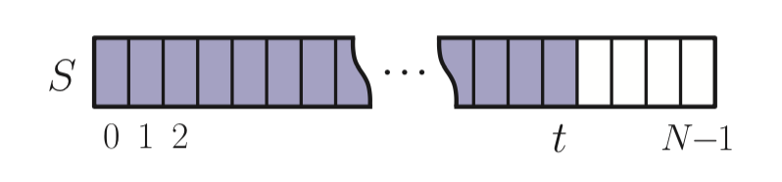
Example Implementation: Array-based Stack
A simple way of implementing the Stack ADT uses an array
We add elements from left to right
A variable keeps track of the index of the top element

Slide 9
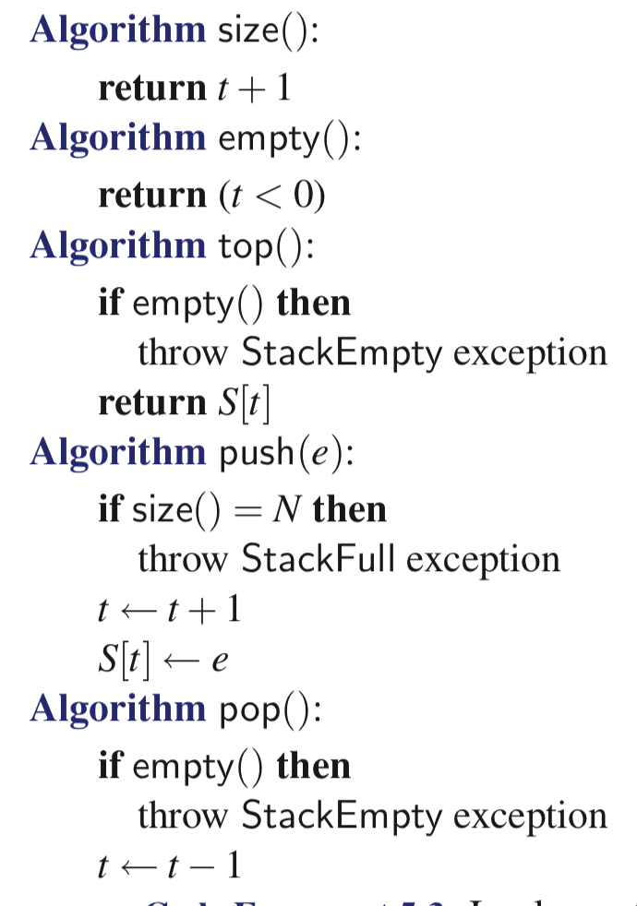
Example Implementation: Array-based Stack
A simple way of implementing the Stack ADT
Add elements from left to right
A variable keeps track of the index of the top element
The array storing the stack elements may become full
A push operation will then throw a StackFull exception
Limitation of the array-based implementation
Not intrinsic to the Stack ADT

Slide 10
Performance and Limitations
Performance
Let n be the number of elements in the stack
The space used is O(n)
Each operation runs in time O(1)
Limitations
The maximum size of the stack must be defined a priori and cannot be changed
Trying to push a new element into a full stack causes an implementation-specific exception
Linked-list based Stack in the text (Chapter 5.1.5)

Slide 11
Array-based Stack in C++
template <typename E> class ArrayStack { private:
E* S; // array holding the stack int cap; // capacity
int t; // index of top element
public:
// constructor given capacity ArrayStack(int c) : S(new E[c]), cap(c), t(-1) { }
void pop() { if (empty()) throw StackEmpty (“Pop from empty stack”); t--; }
void push(const E& e) {
if (size() == cap) throw
StackFull(“Push to full stack”);
S[++ t] = e;
}
… (other methods of Stack interface)

Slide 12
Example use in C++
* indicates top
ArrayStack<int> A; // A = [ ], size = 0
A.push(7); // A = [7*], size = 1
A.push(13); // A = [7, 13*], size = 2
cout << A.top() << endl; A.pop(); // A = [7*], outputs: 13
A.push(9); // A = [7, 9*], size = 2
cout << A.top() << endl; // A = [7, 9*], outputs: 9
cout << A.top() << endl; A.pop(); // A = [7*], outputs: 9
ArrayStack<string> B(10); // B = [ ], size = 0
B.push("Bob"); // B = [Bob*], size = 1
B.push("Alice"); // B = [Bob, Alice*], size = 2
cout << B.top() << endl; B.pop(); // B = [Bob*], outputs: Alice
B.push("Eve"); // B = [Bob, Eve*], size = 2

Slide 13
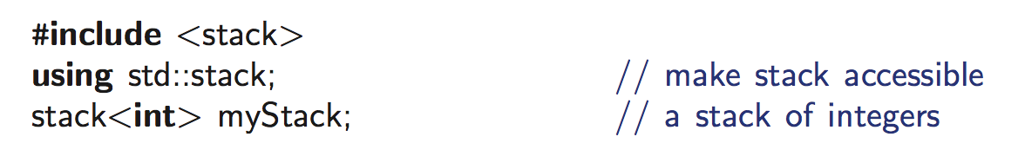
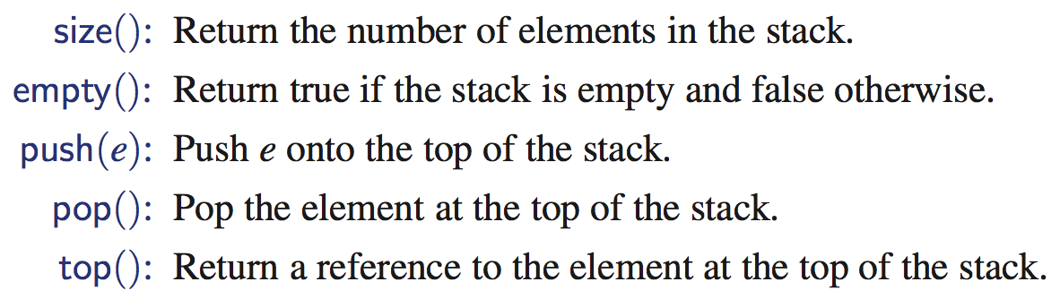
Stack in C++ STL

Slide 14
Example: Parentheses Matching
Each “(”, “{”, or “[” must be paired with a matching “)”, “}”, or “[”
correct: ( )(( )){([( )])}
correct: ((( )(( )){([( )])}
incorrect: )(( )){([( )])}
incorrect: ({[ ])}
incorrect: (
Good Programmer
Someone who thinks that stack is a good data structure for the above task

Slide 15
Example: Computing Spans
Given an an array X, the span S[i] of X[i] is the maximum number of consecutive elements X[j] immediately preceding X[i] and such that X[j] ≤ X[i]
Spans have applications to financial analysis
E.g., stock at 52-week high
X
6 | 3 | 4 | 5 | 2
1 | 1 | 2 | 3 | 1
S

Slide 16
Algorithm: span1
i
X
6 | 3 | 4 | 5 | 2
1 | 1 | 2 | 3 | 1
S
Loop over i = 0, 1, 2, 3, 4
For each i, compute S[i]. How?
From X[i] downward on, compute the number of elements which are consecutively smaller than X[i]

Slide 17
Quadratic Algorithm
Algorithm spans1(X, n)
Input array X of n integers
Output array S of spans of X #
S ← new array of n integers n
for i ← 0 to n − 1 do n
s ← 1 n
while s ≤ i ∧ X[i − s] ≤ X[i] 1 + 2 + …+ (n − 1)
s ← s + 1 1 + 2 + …+ (n − 1)
S[i] ← s n
return S 1
Algorithm spans1 runs in O(n²) time

Slide 18
Algorithm: span2
top
top
top
top
top
1
1
2
3
Algorithm spans2(X, n)
S ← new array of n integers
A ← new empty stack
for i ← 0 to n − 1 do
while (¬A.empty() ∧
X[A.top()] ≤ X[i] ) do
A.pop()
if A.empty() then
S[i] ← i + 1
else
S[i] ← i − A.top()
A.push(i)
return S
X
6 | 3 | 4 | 5 | 2
S
1
1
2
3
1
From index 3 to 1, I am sure that X[4] is the “consecutive largest”.
So, please check X[0] after it
From index 2 to 1, I am sure that X[2] is the “consecutive largest”.
So, please check X[0] after it
4
1
3
2
0
Stack for “index”

Slide 19
Computing Spans with a Stack
We keep in a stack the indices of the elements visible when “looking back”
We scan the array from left to right
Let i be the current index
We pop indices from the stack until we find index j such that X[i] < X[j]
We set S[i] ← i − j
We push x onto the stack

Slide 20
Linear Algorithm
Each index of the array
Is pushed into the stack exactly one
Is popped from the stack at most once
The statements in the while-loop are executed at most n times
Algorithm spans2 runs in O(n) time
Algorithm spans2(X, n) #
S ← new array of n integers n
A ← new empty stack 1
for i ← 0 to n − 1 do n
while (¬A.empty() ∧
X[A.top()] ≤ X[i] ) do n
A.pop() n
if A.empty() then n
S[i] ← i + 1 n
else
S[i] ← i − A.top() n
A.push(i) n
return S 1

